Slide 1
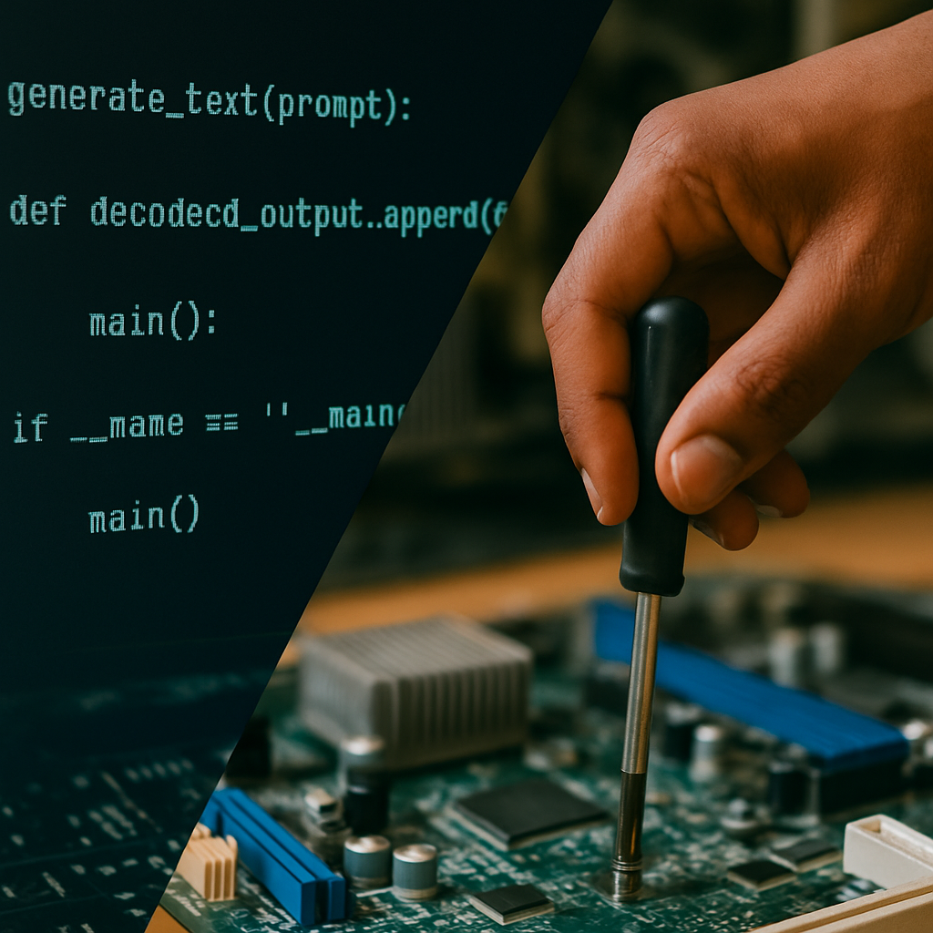

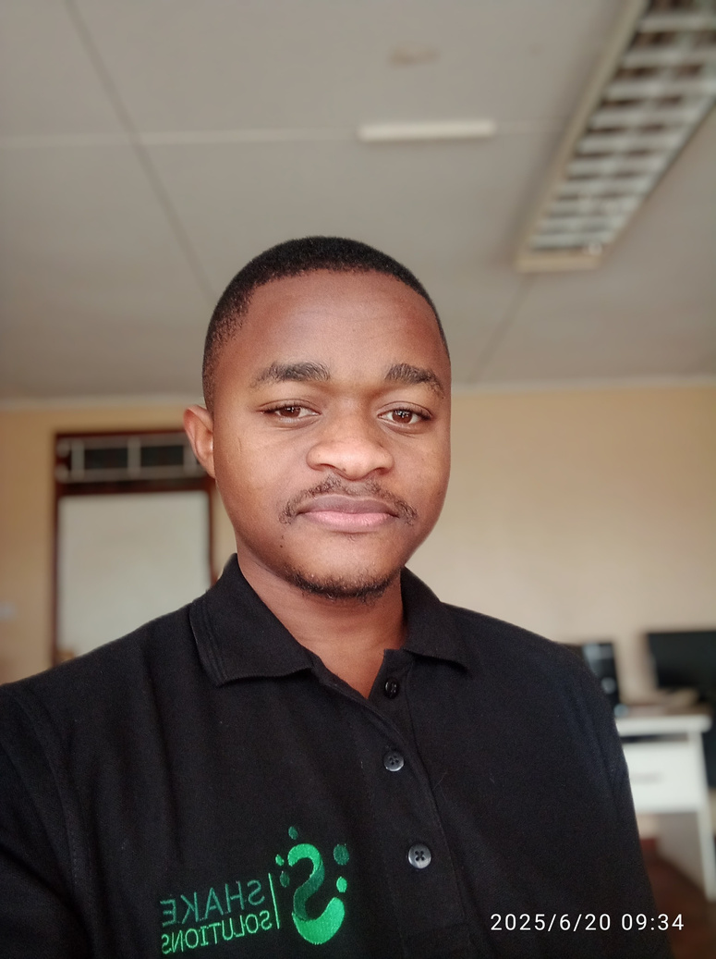
Full stack engineer | Technical support
PRINCE B. KALUWA
A seasoned ICT expert with over two year’s experience. My journey in the ICT field has enabled me to master various areas, including systems administration, Full-stack website development, technical support, and digital marketing.

Slide 2
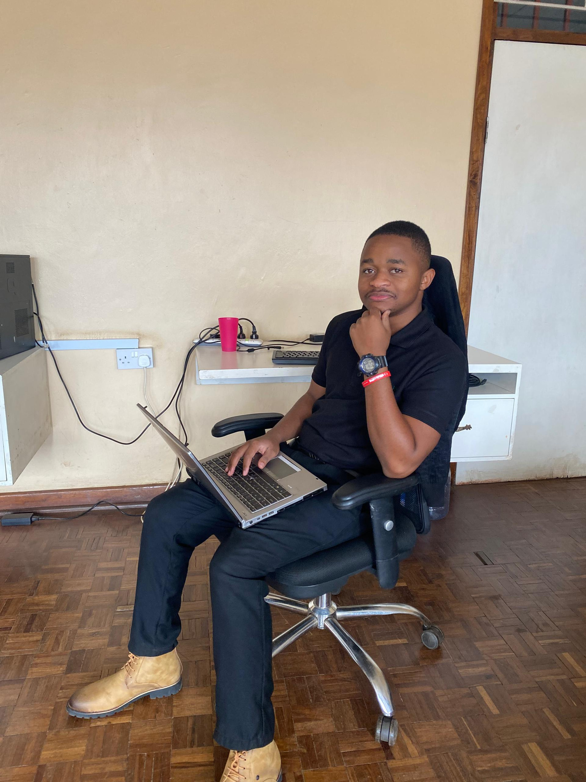
ABOUT
i am an ICT expert with a diverse skill set in systems administration, web development, technical support, and digital marketing. I specialize in designing robust IT infrastructures, creating user-friendly websites, and ensuring system security and stability.
My focus is on driving success through innovative ICT solutions and leading projects that demonstrate my technical expertise and commitment to excellence

Slide 3

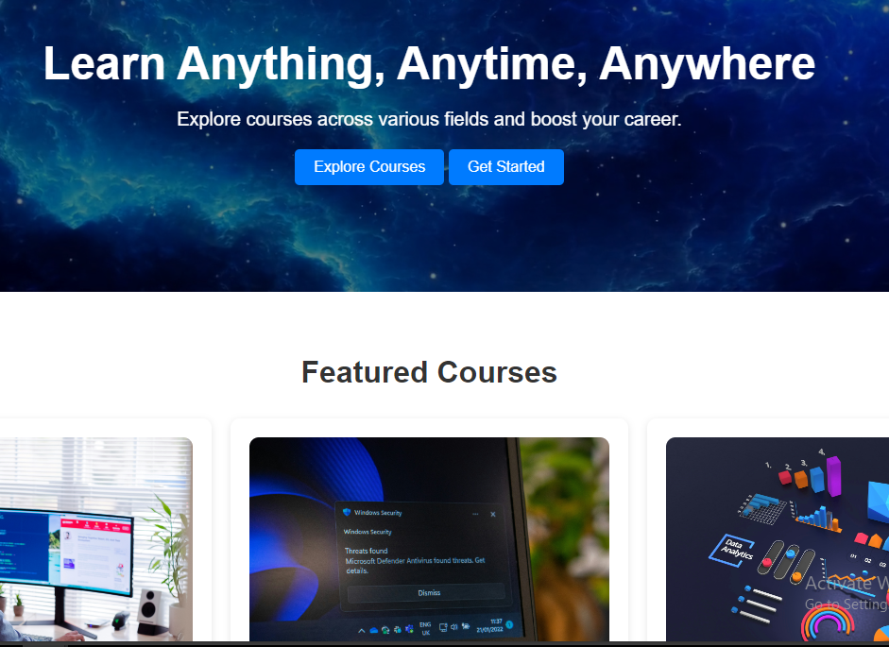
SAMPLE WORK
website Design
A learning platform concept design

Slide 4
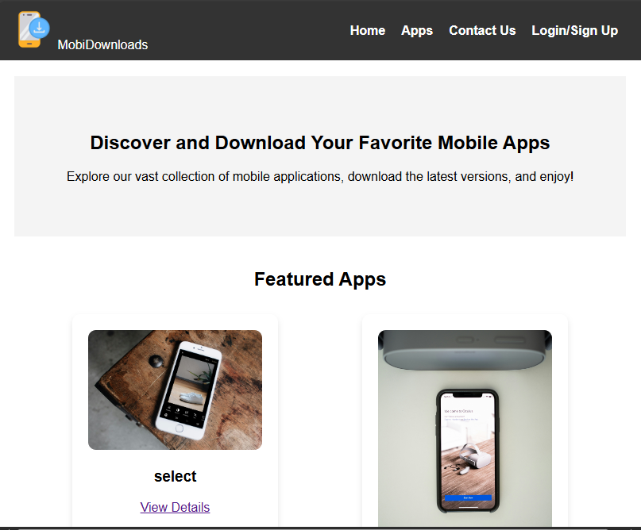
SAMPLE WORK
Website Design
Mobile application website

Slide 5
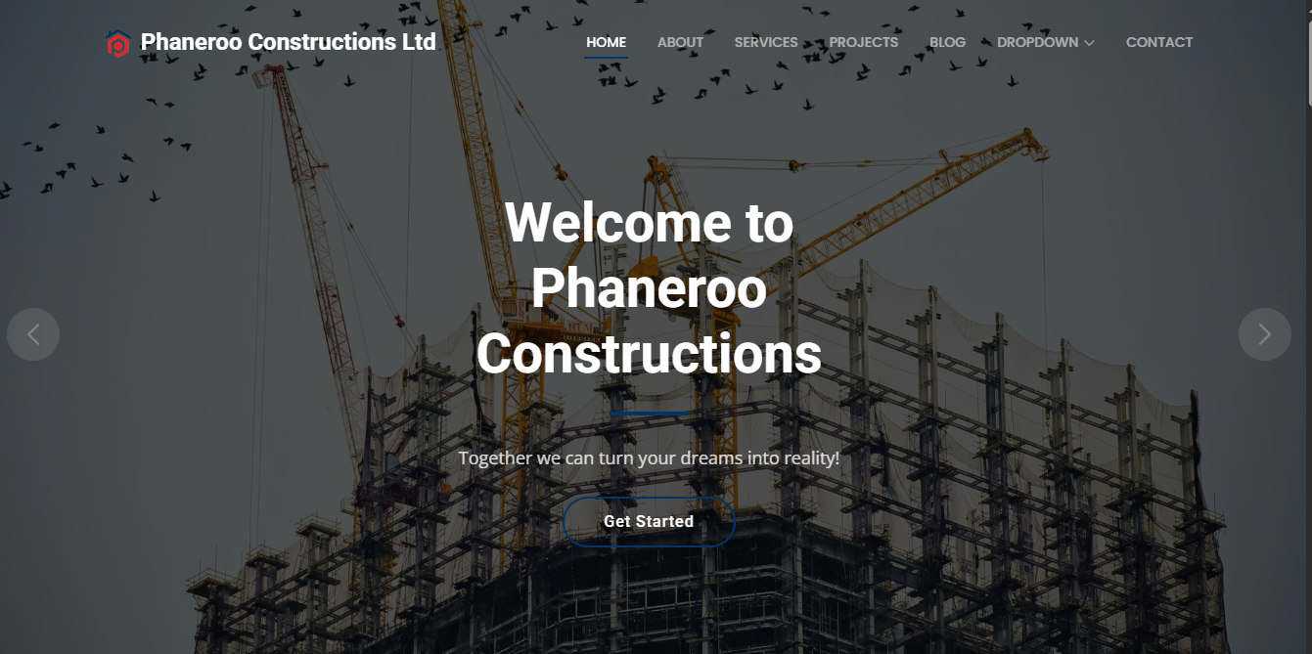
SAMPLE WORK
Website Design
Construction website concept Design

Slide 6
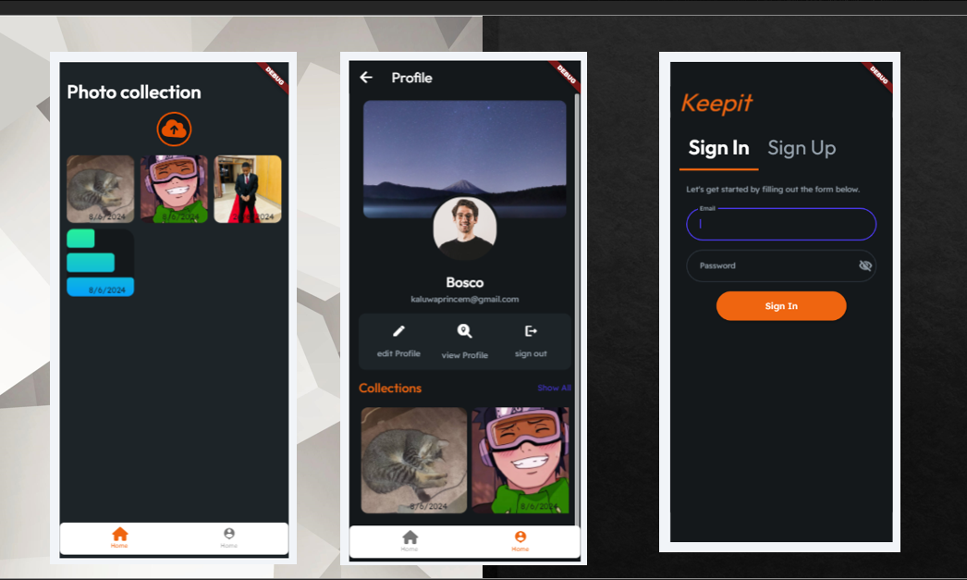
SAMPLE WORK
Mobile application
Cloud storage application for pictures

Slide 7
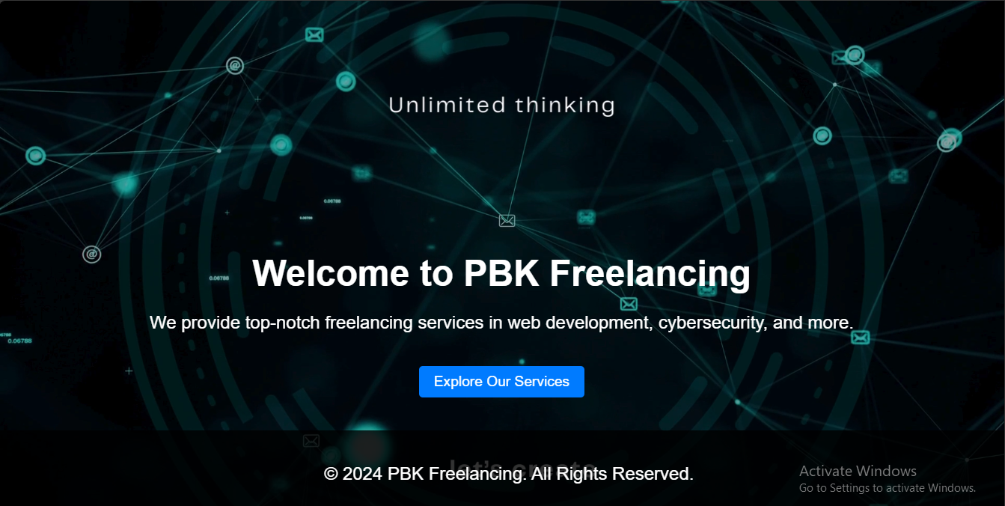
SAMPLE WORK
Website development
Website for an ICT Startup

Slide 8
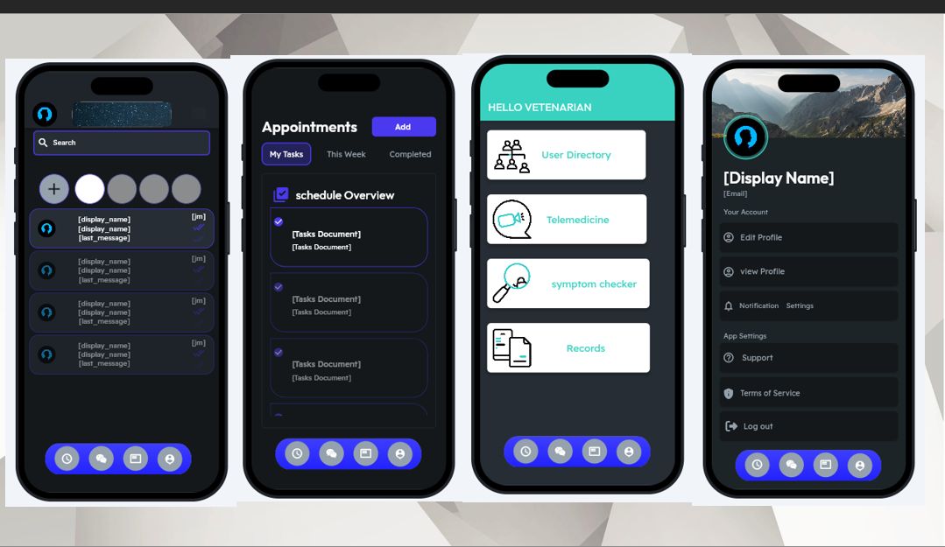
SAMPLE WORK
Mobile application
Vetcare Application

Slide 9
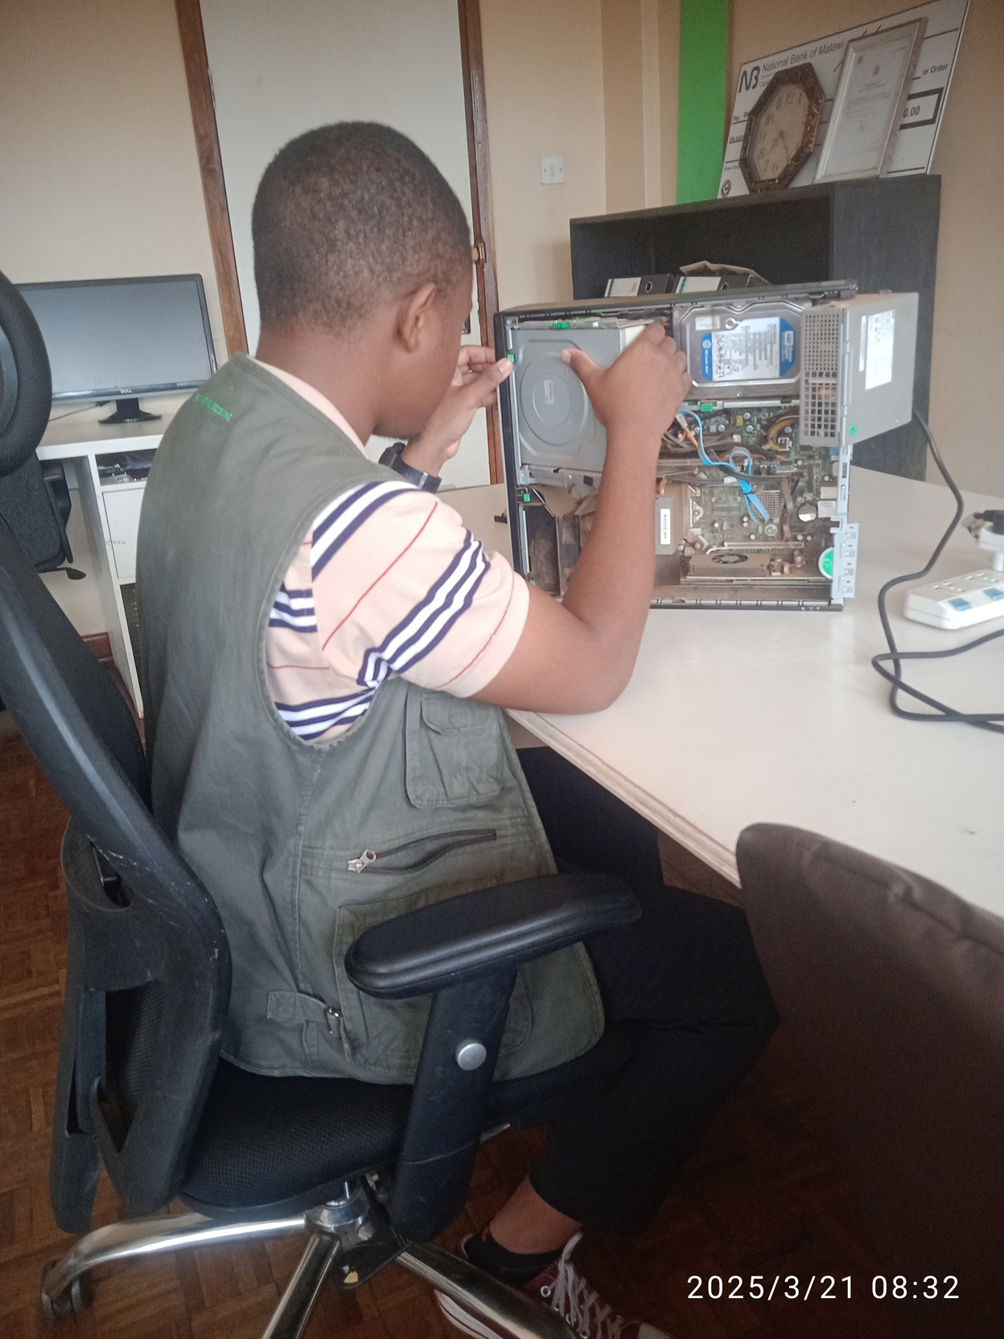

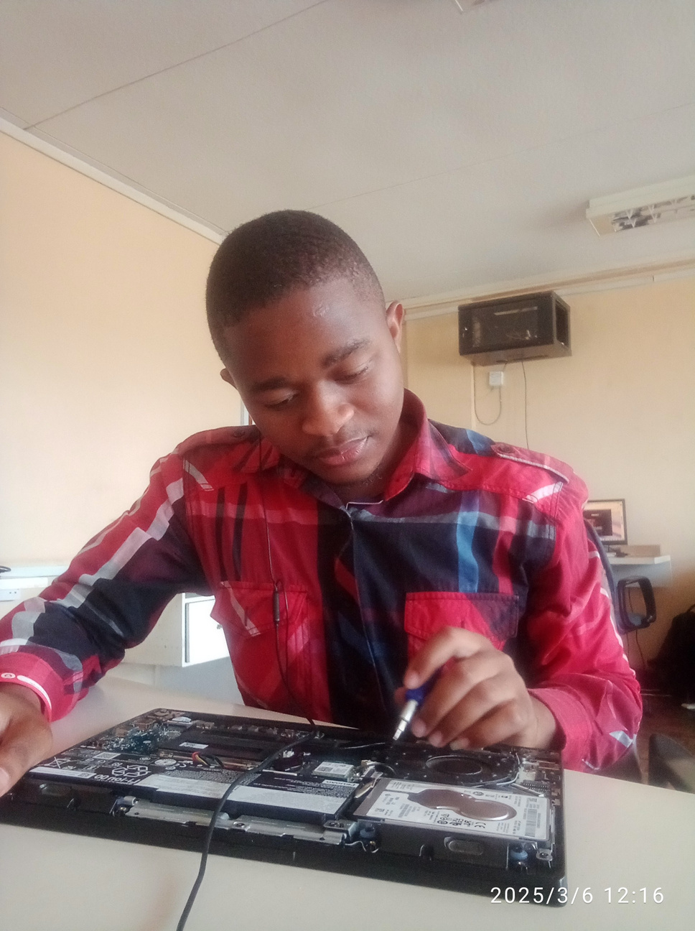
TECH SKILLS
Computer Repairs
Computer Hardware Troubleshooting
Hardware
Components
Component installments
and upgrades
Cleaning

Slide 10
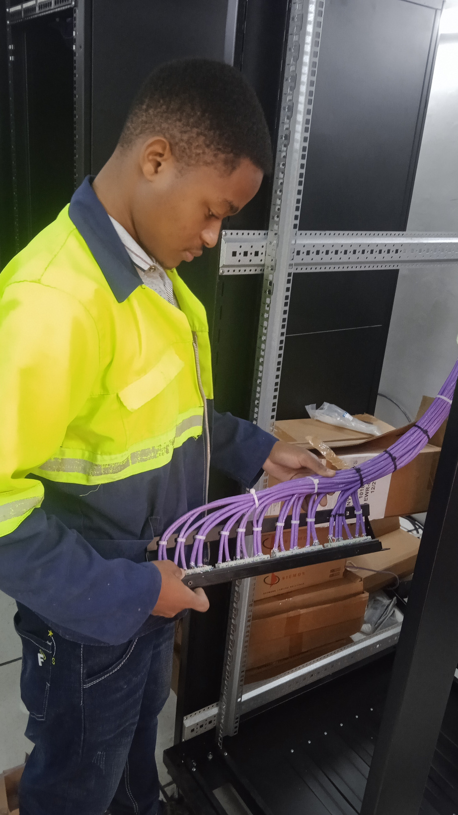
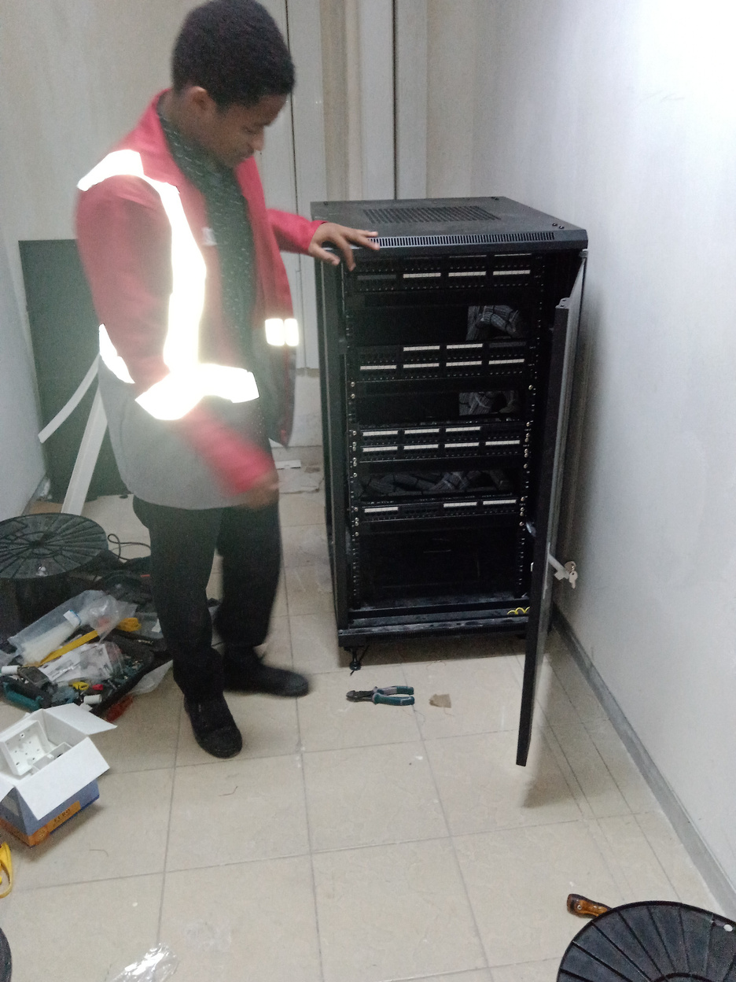

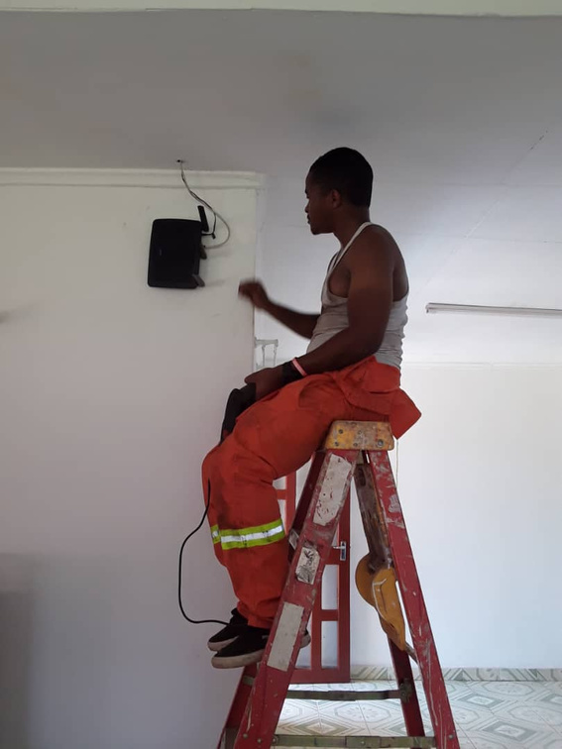
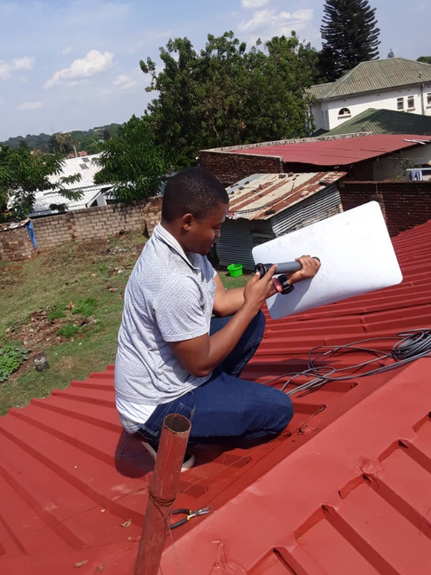
TECH SKILLS
punch panel, switch & router configuration
cabinet assembly & installments
Server configuration
Networking
ethernet cable termination
Starlink installments
Network
Troubleshooting

Slide 11
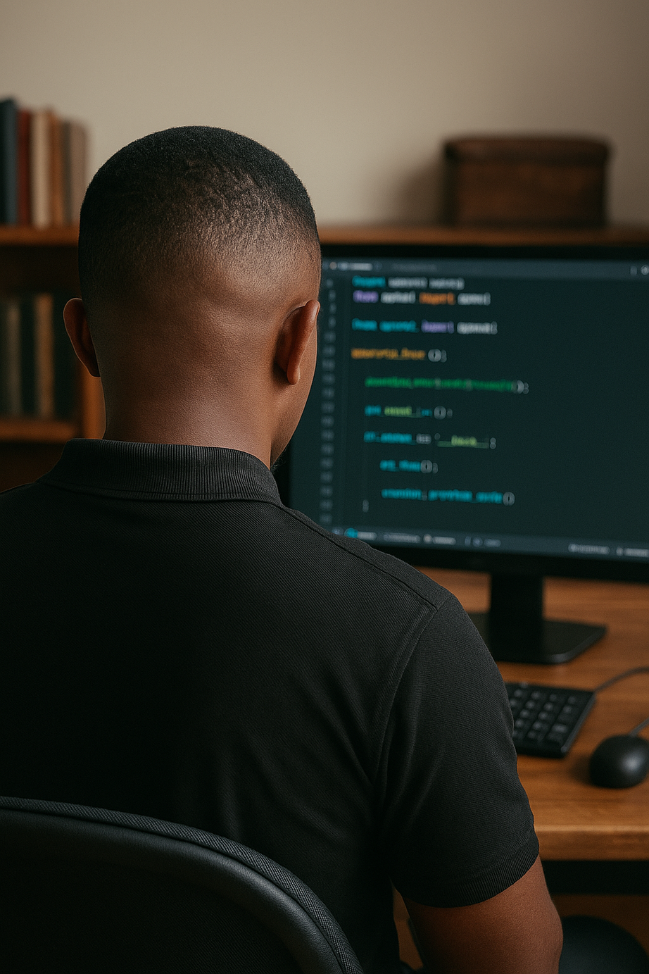
TECH SKILLS
Operating system
Installation
Customization
Upgrade
Driver installation
Anti- virus
Installation
Customization
sofware
Software
Installation
Upgrade
Inspection
Disk management

Slide 12
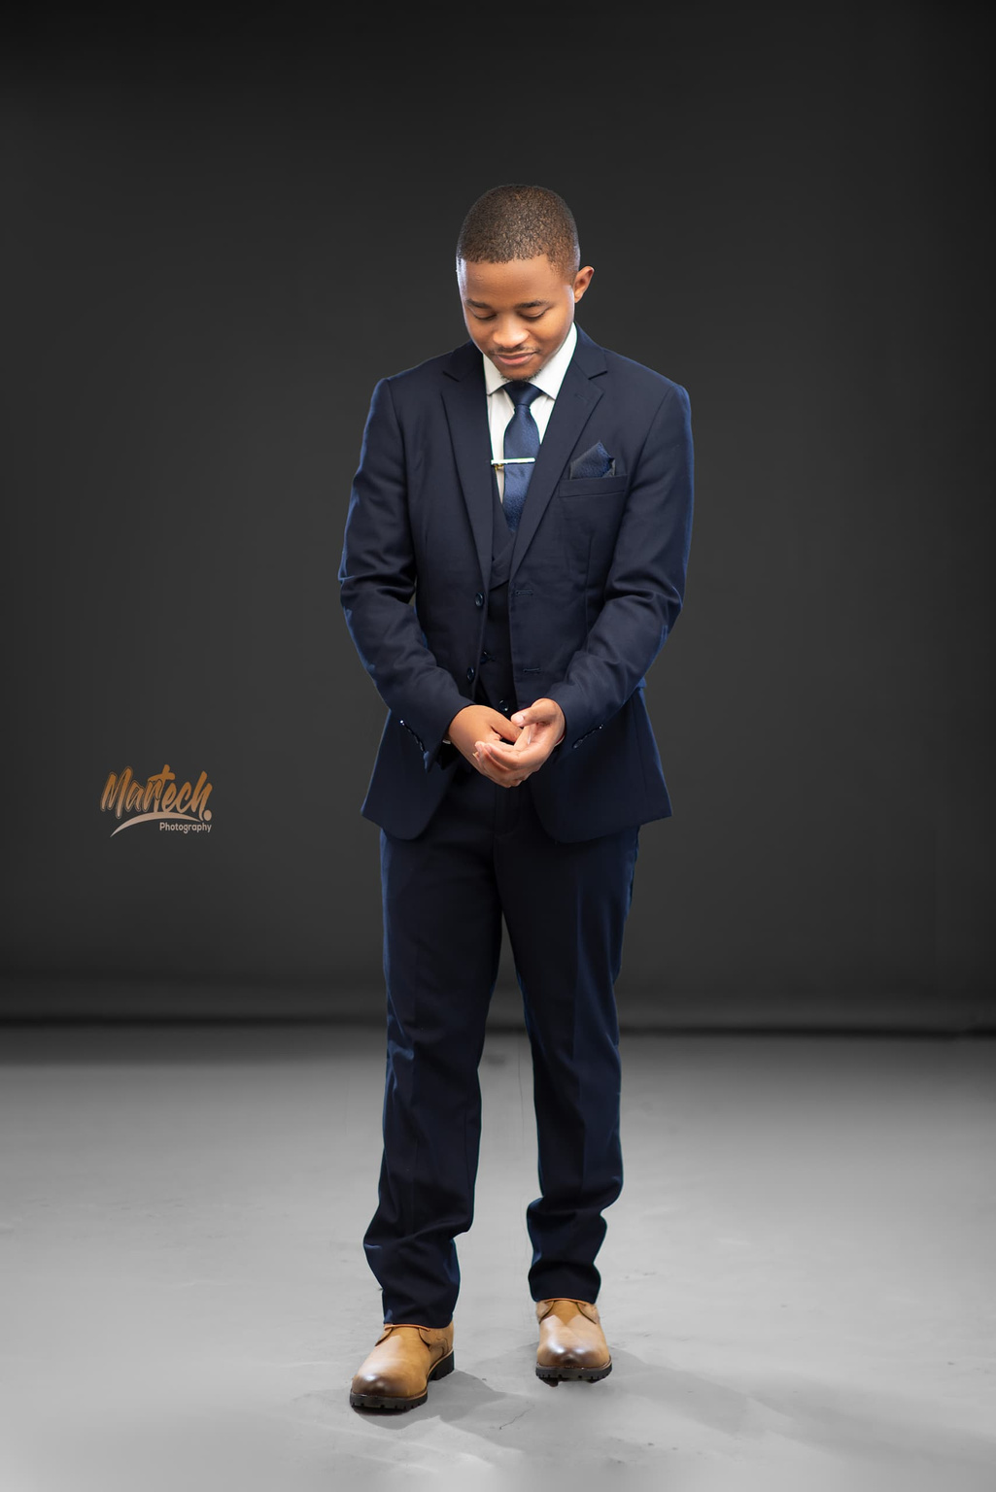





GET IN TOUCH TODAY
+265 999 561 582
https://b-kaluwa.github.io/My-Portfolio/
kaluwaprincem@gmail.com
Lilongwe, Malawi, Africa

